Slide 1


Q - Integrating Improvement
10 October 2024

Slide 2
About Q

Slide 3
We are a community of over 5,000 people across the UK and Ireland, collaborating to improve the safety and quality of health and care.
Notes:
​​

Slide 4
What is improvement?

Slide 5
What is improvement?
Quality improvement is about giving the people closest to issues affecting care quality the time, permission, skills and resources they need to solve them.
It involves a systematic and coordinated approach to solving a problem using specific methods and tools with the aim of bringing about a measurable improvement.
Notes:
​​Done by people not too people

Slide 6
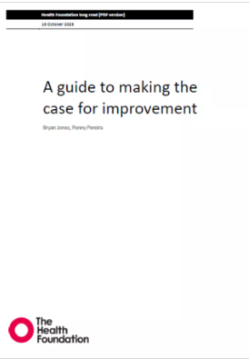
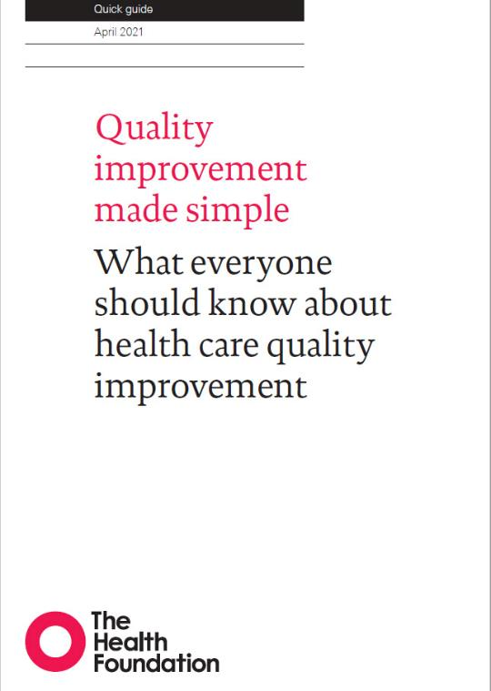
What is improvement?
Notes:
​​

Slide 7
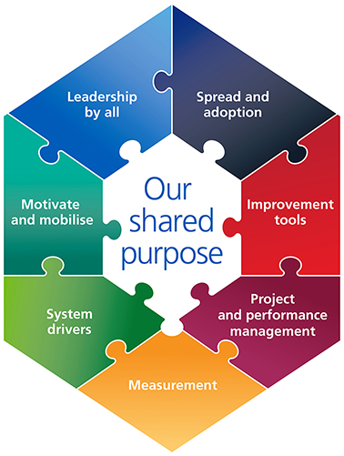

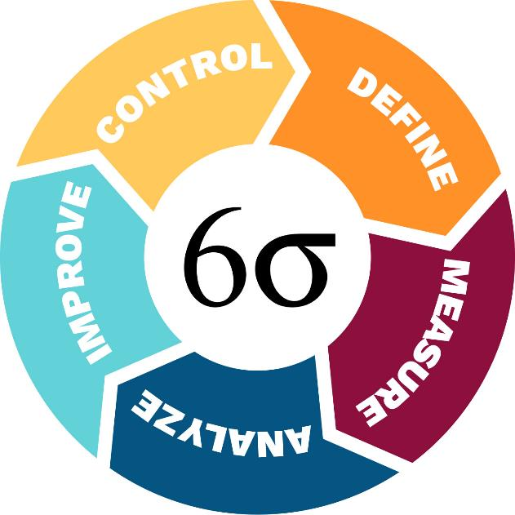
What is improvement?
Notes:
​​

Slide 8
What is improvement?
Involve patients and carers: Patients and carers can help design, implement, and evaluate QI projects. For example, they can help create surveys or map out processes from their perspective.
Use a systematic approach: QI uses a systematic approach to tackle complex problems.
Focus on outcomes: QI focuses on outcomes and gives everyone a voice.
Use subject matter expertise: QI uses the expertise of staff and service users to identify and test potential solutions.
Use tools: QI uses tools like process maps, fishbone diagrams, and driver diagrams to help build a picture of what needs to be improved.
Share results: QI results are shared at meetings so everyone can add, amend, or comment.
Notes:
​​

Slide 9
Why improvement?
Benefits to workforce
Improved culture
Higher job satisfaction
Development of key skills
Notes:
​​

Slide 10
Why improvement?
Benefits to patients, service users and society
Improved safety
Improved experience
Improved outcomes
Notes:
​​

Slide 11
Why improvement?
Benefits to organisations
Effective focussing of scarce resources
Productivity gains
Improved workforce capability
Notes:
​​

Slide 12
Why improvement?
Benefits to systems
Stronger collaboration
Improved flow between sectors
More effective scaling of innovation
Notes:
​​

Slide 13
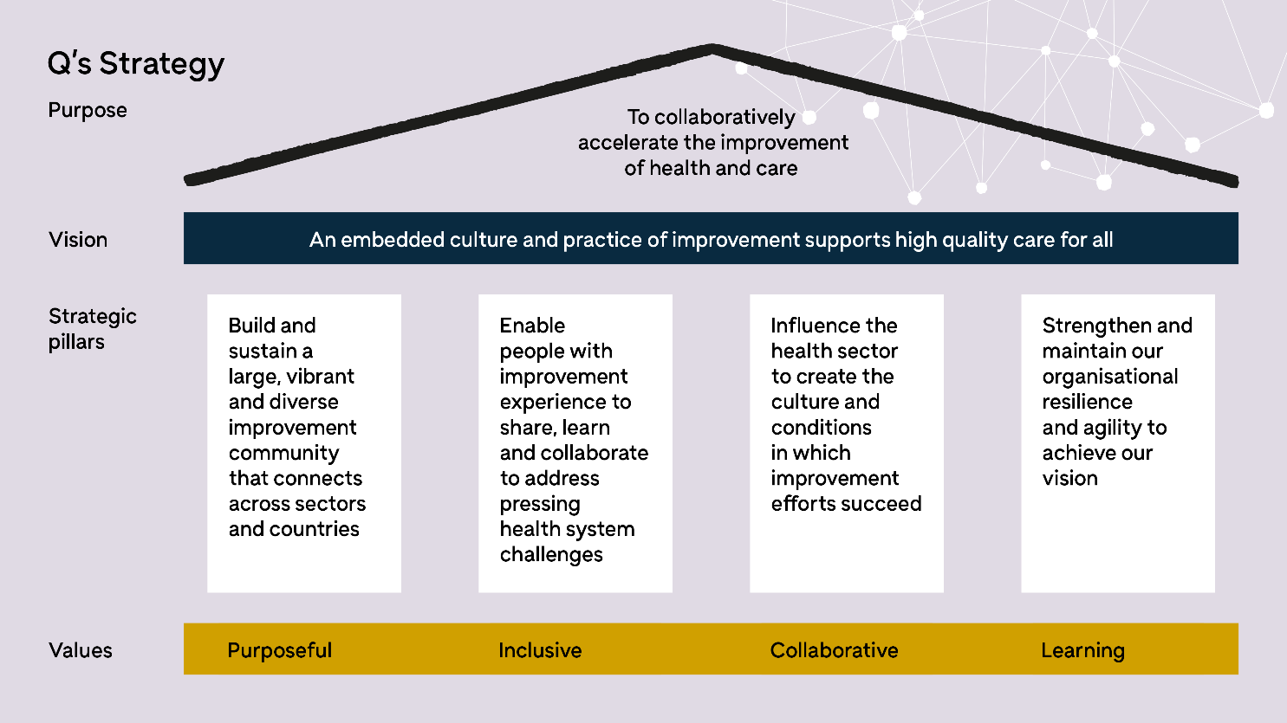
Notes:
Highlight vision. Not about improvement people or functions – about everyone
​​

Slide 14
Liberating Structure
15%

Slide 15

15% Solutions
Liberating Structures - Attribution: Liberating Structure developed by Henri Lipmanowicz and Keith McCandless. Inspired by professor Gareth Morgan.
How it will work
5 min to think:
What is your 15 percent? Where do you have discretion and freedom to act? What can you do without more resources or authority?
In pairs – share your ideas, one person at a time – 3 mins each
Join another pair to make four, share and provide consultation to one another (asking clarifying questions and offering advice, 5 mins per person, one at a time
Take your 15% and have a go at implementing them

Slide 17

Final reflections

Slide 18
Thank you
8 Salisbury Square
London EC4Y 8AP
T +44 (0)20 7664 4661
E q@health.org.uk
@theQCommunity
q.health.org.uk

